Slide 1
Customer Churn Modelling

Slide 2
Introduction:
What is Churn Modelling?
Churn modelling identifies which customers are at high risk of canceling their subscription.
Churn prediction tell whether a customer will leave and why?
Steps to create churn prediction
Data Preparation: The data preparation involves gathering relevant data and preparing it for the use in model.
Exploratory Data Analysis: This aims to understand the data and discern the factor behind customer churn in business.
Prediction: Find step of data science model at identify high-risk customers before they churn.

Slide 3
Goal:
1. Customer Demographics:
- What is the distribution of customers across different age groups?
- Analyse the gender distribution of customers.
2. Churn Analysis:
- What percentage of customers have churned?
- What are the main reasons for customer churn?
- Identify any patterns or trends among customers who have churned.
3. Product Usage:
- What are the most commonly used products or services?
- Analyse the usage patterns of different customer segments.
4. Financial Analysis:
- What is the average account balance of customers?
- Compare the financial characteristics of churned vs. non-churned customers.
5. Predictive Modelling:
- Which factors are the most significant predictors of customer churn?
- Develop a predictive model to identify at-risk customers.

Slide 4
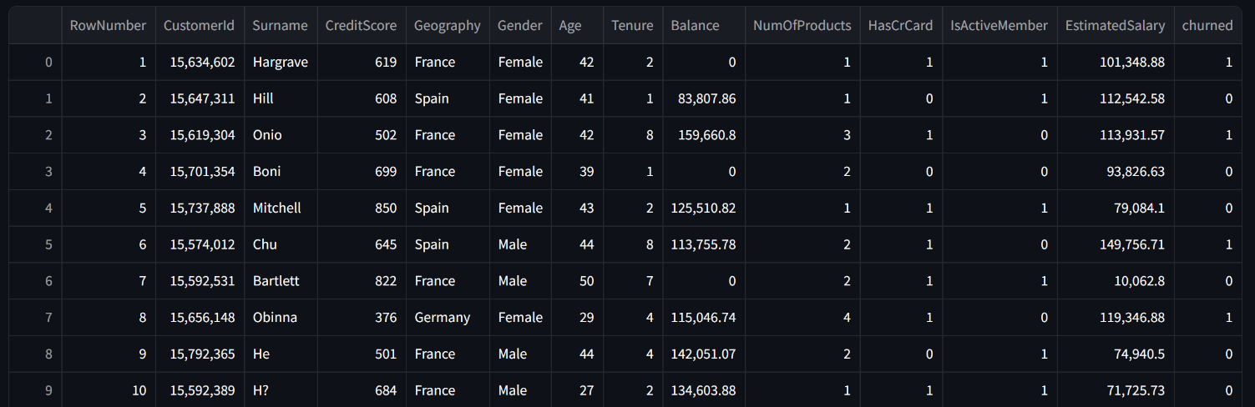
About the Data:
There are 10000 rows.
There are 14 column.

Slide 5
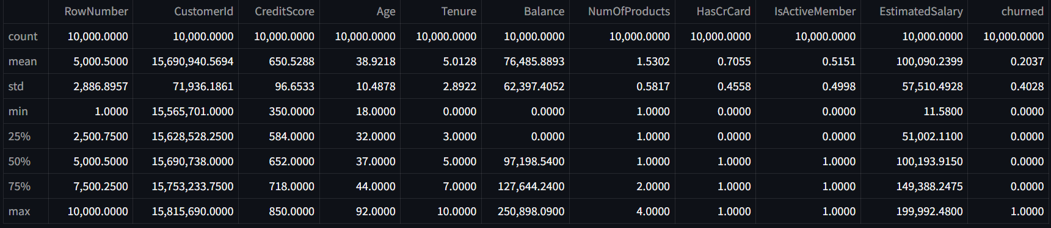
Descriptive Statistics
There are 10000 rows and all the non null.
The mean credit score of customers is approximately 650.
The mean age of customers is 39
Mean balance of customers is 76,485.88
Maximum Credit score of a customer is 850
Maximum balance of a customer is 250,898
Maximum estimated salary of customer is 199,992.48

Slide 6
Customer Demographics

Slide 7
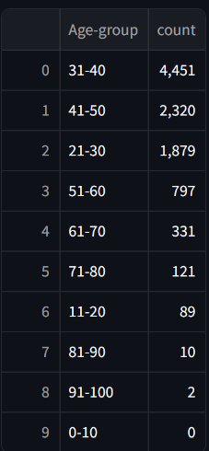
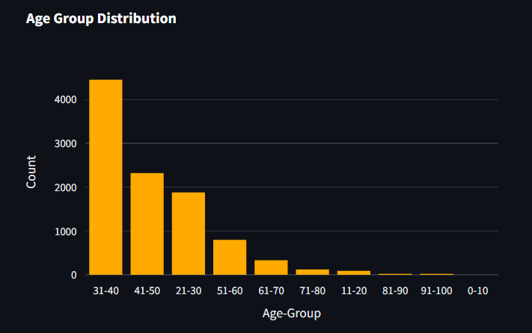
Distribution of customers across different age groups:
The customer between the age-group 31-40 are more which is 4451
No customers between the age 0-10
Very less customers are in between 91-100
The customers between the age 21-30 are 1879

Slide 8
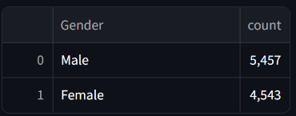
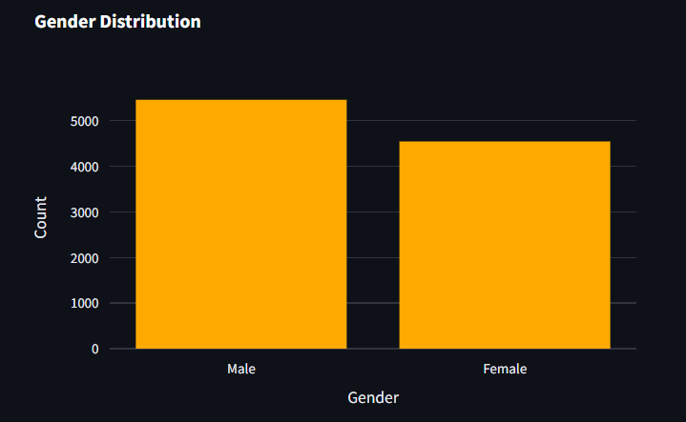
Gender distribution of Customers
Male Customers are more than female customers.
There are 5,457 males and 4543 females.

Slide 9
Churn Analysis

Slide 10
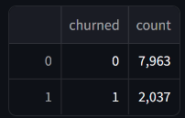
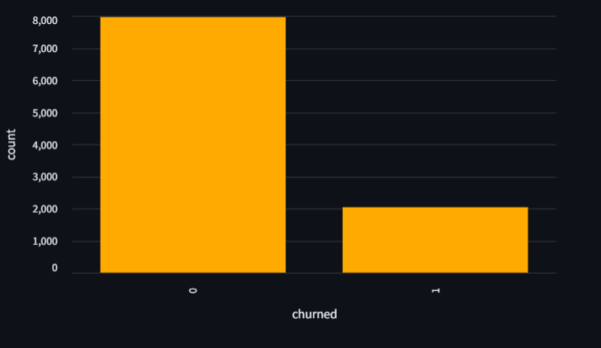
Percentage of customers have churned:
Total number of customers : 10000
Churned Customers : 2037
Percentage of customers have churned : 20.37%

Slide 11
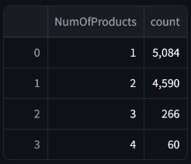
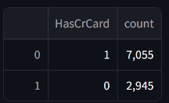
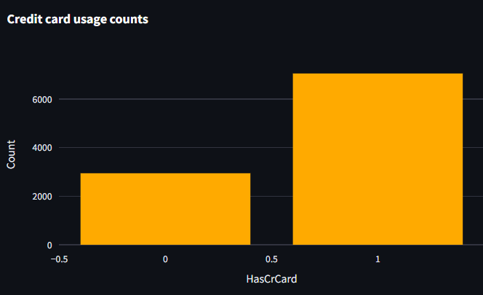
Patterns or trends among customers who have churned.
Product Usage Counts
Credit card Usage Counts
7055 customers have own credit card.
2946 customers have not own credit card
Majority of Customers Use 1 or 2 Products
Few Customers Use More Than 2 Products

Slide 12
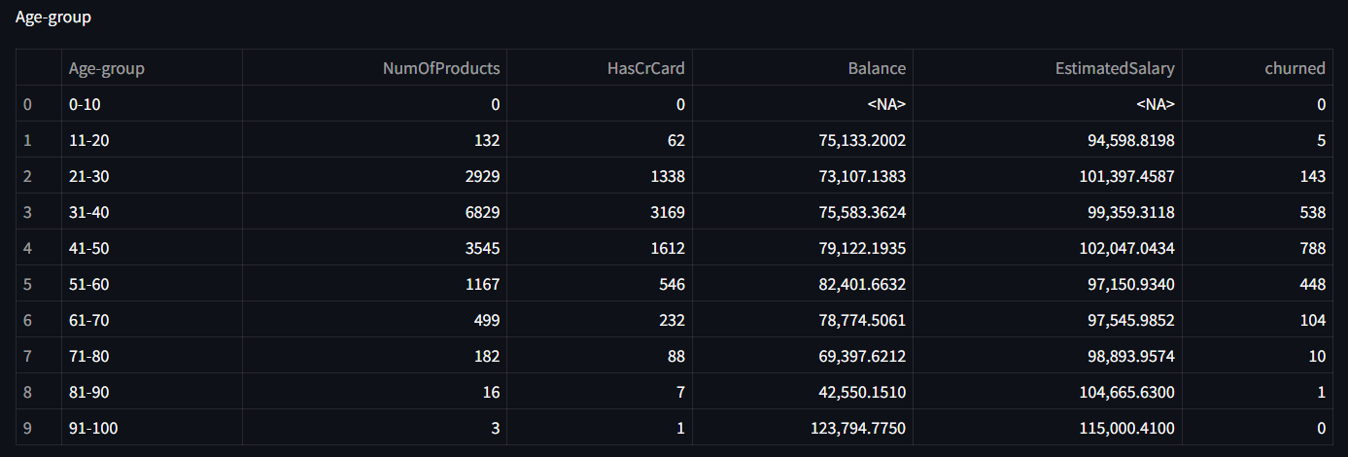
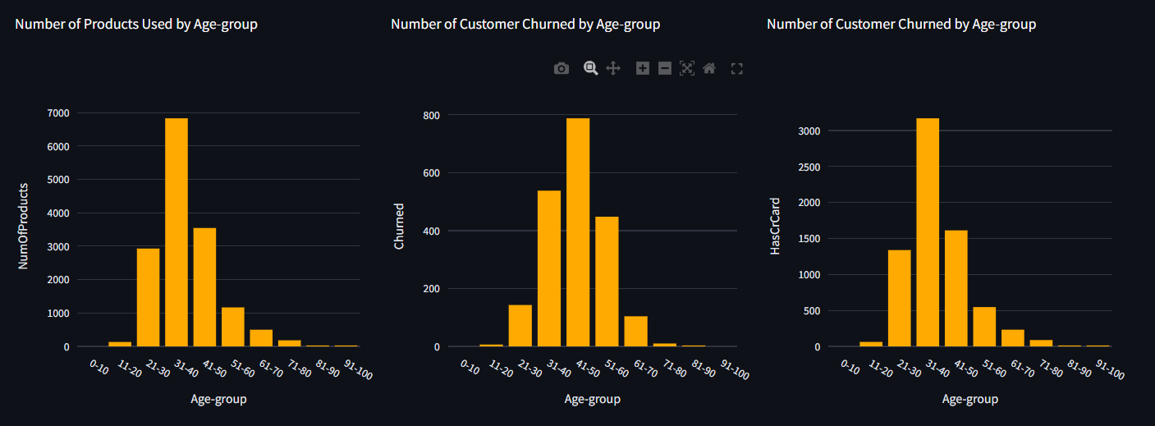
Group by Age-group and compute number of products used and credit card usage
More number of products are used by customers between the 21-30 age group.
The customers with age group 31-40 has more number of credit cards.
Customers with age-group 91-100 have highest mean bank balance which is total of 123,794.7750
Customers in the age group 31-40 have the highest churn rate.
The mean estimate salary of age-group 91-100 is high.
Those who are in the age-group 0-10 have no card, no balance, no estimated salary.

Slide 13
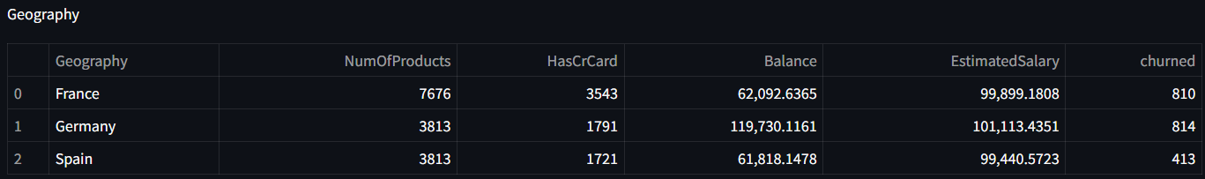
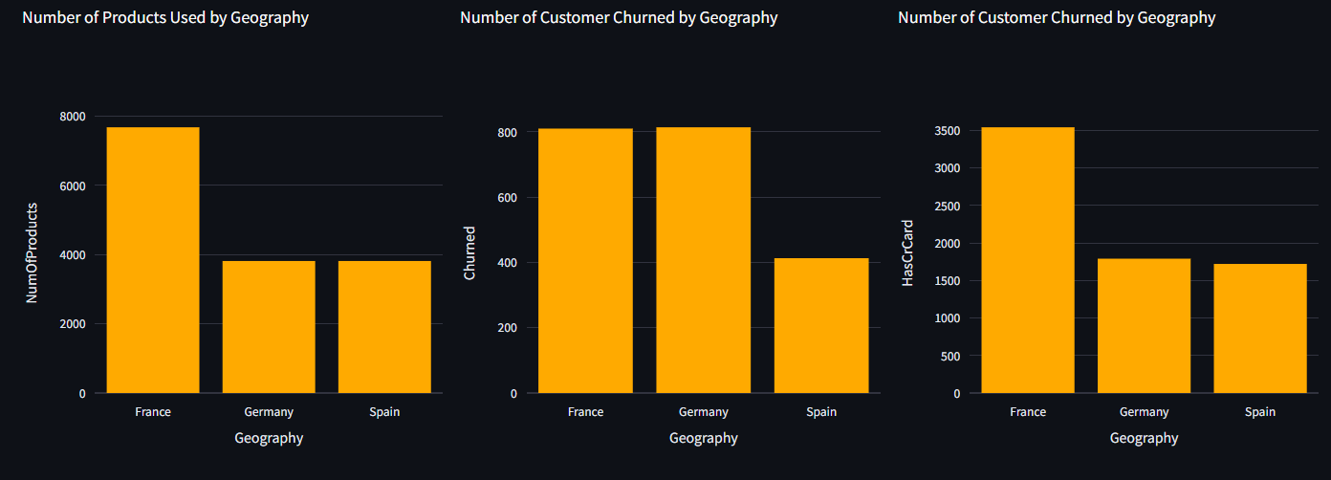
Group by Geography and compute number of products used and credit card usage
Customer who live in Germany has the highest churn rate.
Number of products use by more, who live in France.
Spain has the lowest churn rate.
Germany has the highest mean balance and estimated salary.

Slide 14
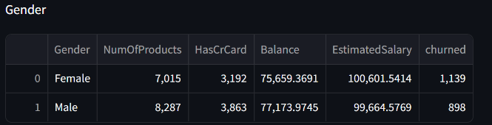
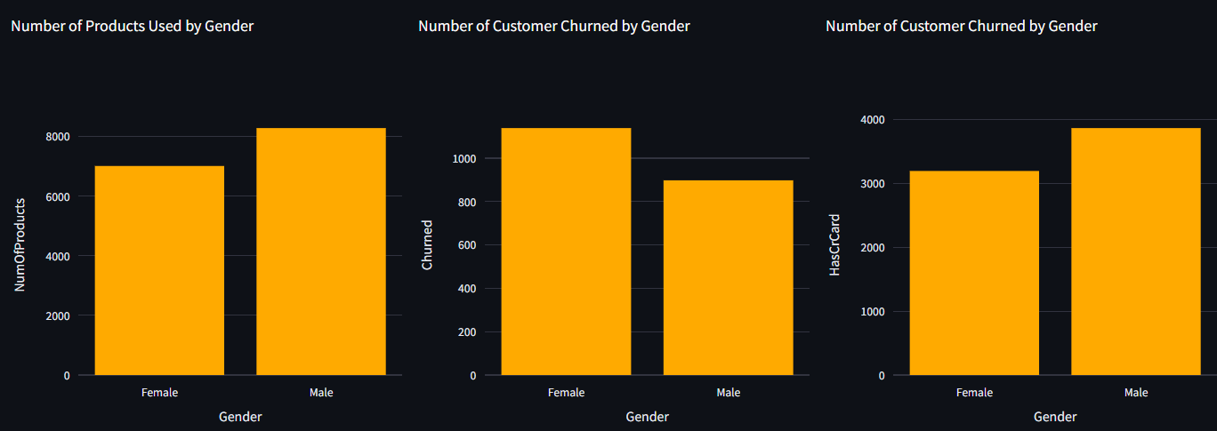
Group by Gender and compute number of products used and credit card usage
The churn rate by the female customers is high
Number of products used by male customers is more.
Male customers has more number of credit cards.
Mean balance of male is high.
Mean estimated salary of female is high.

Slide 15
What are the main reasons for customer churn?
31-40 age-group has the highest churn rate, possibly due to career transitions, family growth.
Germany has the highest churn rate despite high balances and salaries, the high churn rate due to dissatisfaction with services or better competitor offers.
Churn rate for female customers is high, this can be due to unmet expectations or lack of targeted services.
High product usage may lead to churn if needs are not met.
In the age-group, financial flexibility may lead to switching banks for better terms or rewards.
Age 91-100 are less likely to churn due to established trust and satisfaction.
Higher product usage, possibly leading to higher susceptibility to churn if better alternatives are found.

Slide 16
Product Usage

Slide 17
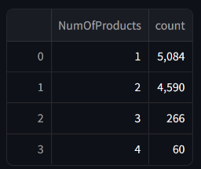
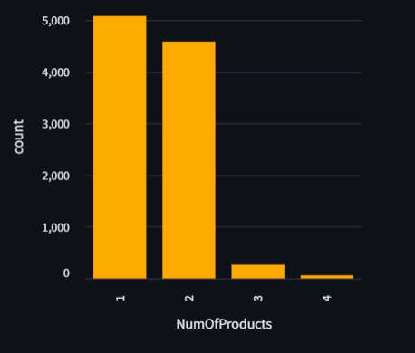
Most commonly used products or services
The NumOfProducts ‘1’ is used by customer more. Means only 1 product is purchased more.

Slide 18
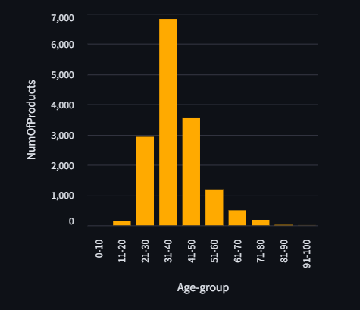
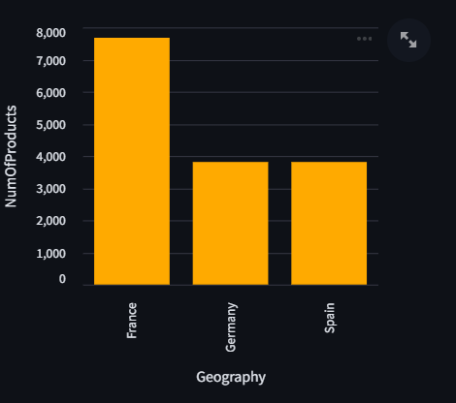
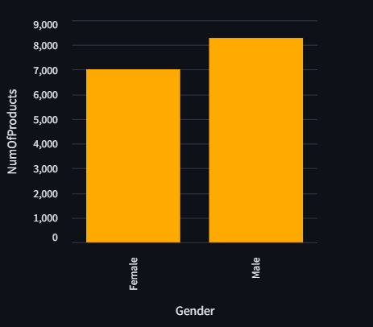
Usage Patterns Of Different Customer Segments.
Num of products used by age-group 31-40 are more.
No products used by age-group 0-10
France uses the number of products more.
The products used males costumer is more than number of products used femals.

Slide 19
Financial Analysis

Slide 20
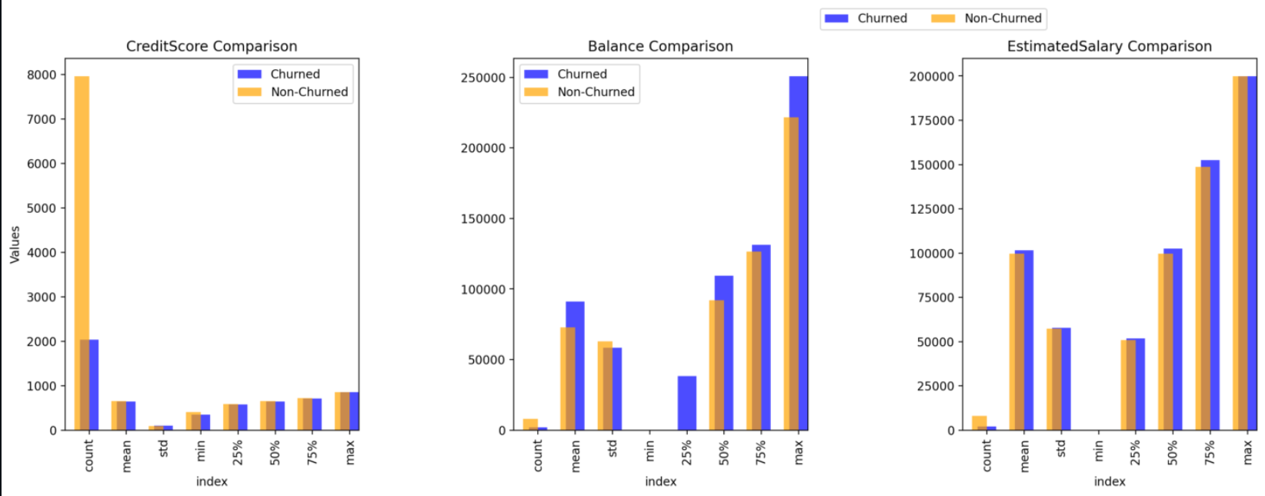
Average account balance of customers: 76485.89
Comparison two datasets across three variables: CreditScore, Balance, and EstimatedSalary.

Slide 21
Predictive Modeling

Slide 22
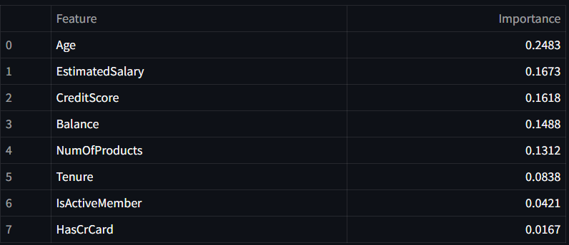
Factors Which Are The Most Significant Predictors Of Customer Churn
The features can be selected as Age, EstimatedSalary, CreditScore, Balance, NumOfProducts

Slide 23
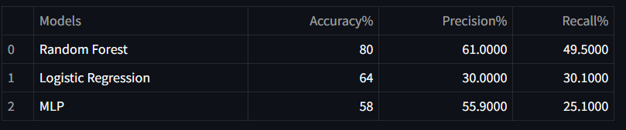
Predictive Model To Identify At-risk Customers
For developing a predictive model, three algorithms are used:
Random Forest
Logistic Regression
Multi Layer Perceptron
Performance metrics such as accuracy score, precision score, and recall is calculated. It is given in the table:
Random Forest gives the highest accuracy, precision, and recall so it can be fine-tuned for better predictions.

Slide 24
Conclusion:
Customer churn modeling is therefore very important for a business entity to forecast cases of churn and possibly manage them. Using the information about customers’ behaviors employers can define important indicators include age, balance and product usage and build up the non–terminating strategies. SMOTE is used to handle a problem of imbalanced data, while models’ performance can be evaluated using the precision, recall, and AUC-ROC measures. Implementing and evaluating the model helps in its calibration to shifts in the customers’ behaviors. Lastly, churn modeling is particularly helpful in that it makes possible timely client interaction, preventative approach, and efficient utilization of resources in an effort to reduce the clients’ loss and improve business performance. To ensure that the model’s value and effectiveness remain consistent with the demands of a constantly changing environment, the model needs to be constantly updated based on fresh data.

Slide 25
Thank You

